Slide 1
Hypothesis Testing 16 Infographics Deck
Compiled presentation for study, teaching, and training
1. Module 1: Foundations of Hypothesis Testing
• Introduction to Hypothesis Testing
• Statistical Hypothesis and Population Parameter
• Null Hypothesis vs Alternative Hypothesis
• Writing Hypotheses Correctly: H₀ and H₁ Format
2. Module 2: Types of Hypothesis Tests
• Right-Tailed Test: Testing for an Increase
• Left-Tailed Test: Testing for a Decrease
• Two-Tailed Test: Testing for Any Difference
• Choosing the Correct Tail: Left, Right, or Two-Tailed Test
3. Module 3: Traditional Testing Method
• Traditional Method of Hypothesis Testing: Step-by-Step Workflow
• Significance Level, Critical Region, and Rejection Region
• Test Statistic and Critical Value Explained
• P-Value Method: Interpreting Evidence Against H₀
4. Module 4: Outcomes, Errors, and Interpretation
• Possible Outcomes of a Hypothesis Test
• Type I and Type II Errors
• Jury Trial Analogy for Hypothesis Testing
• Hypothesis Testing Decision Map and Common Mistakes
Overview of all 16 infographics

Slide 2
Module 1: Foundations of Hypothesis Testing
4 infographic slides
Section 1 of 4

Slide 3
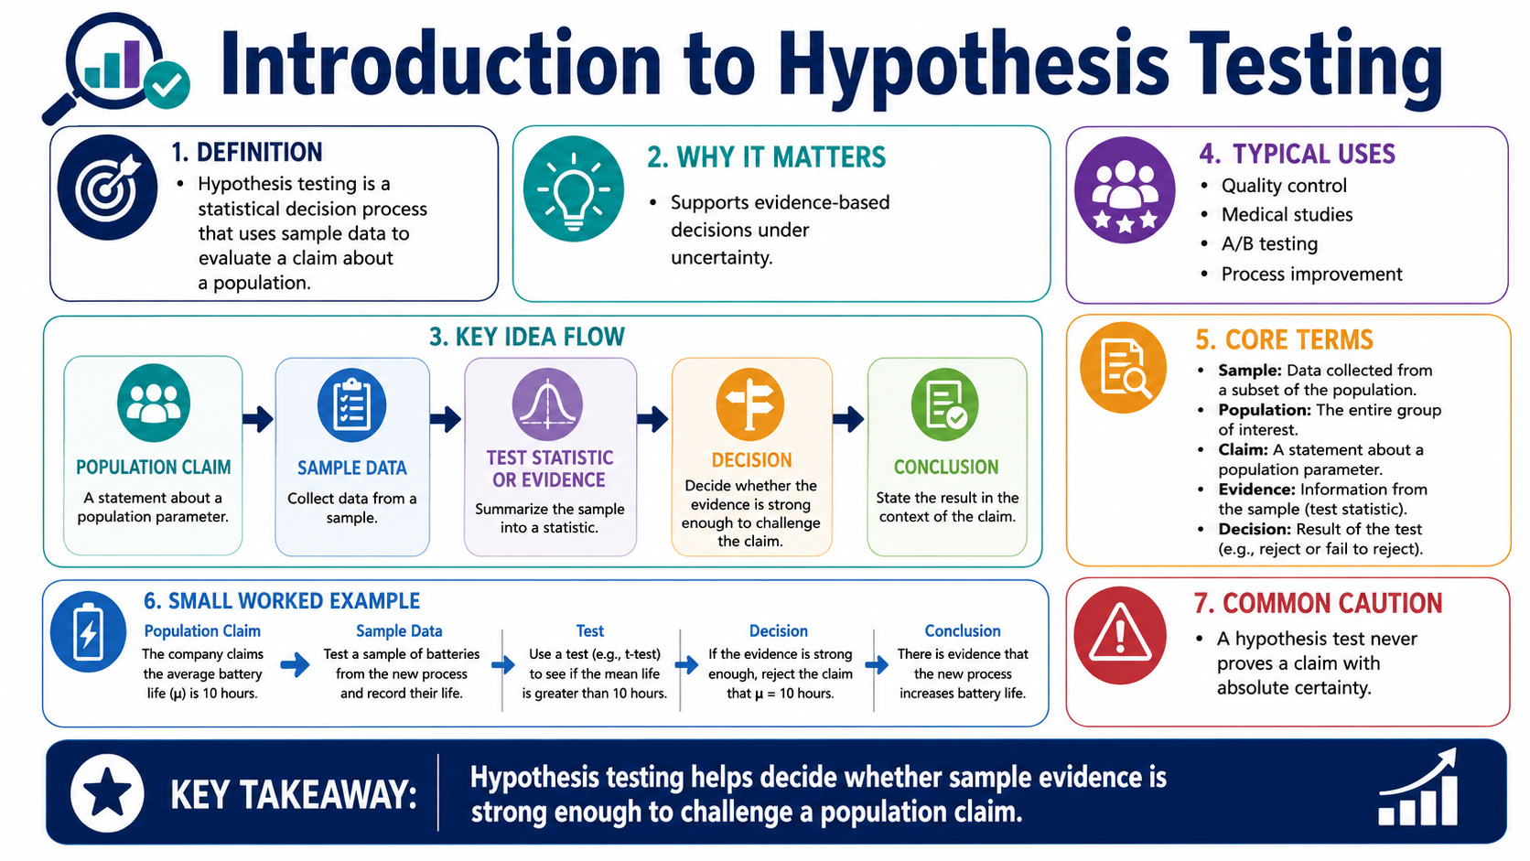
Introduction to Hypothesis Testing
Module 1: Foundations of Hypothesis Testing
Infographic 1 of 16

Slide 4
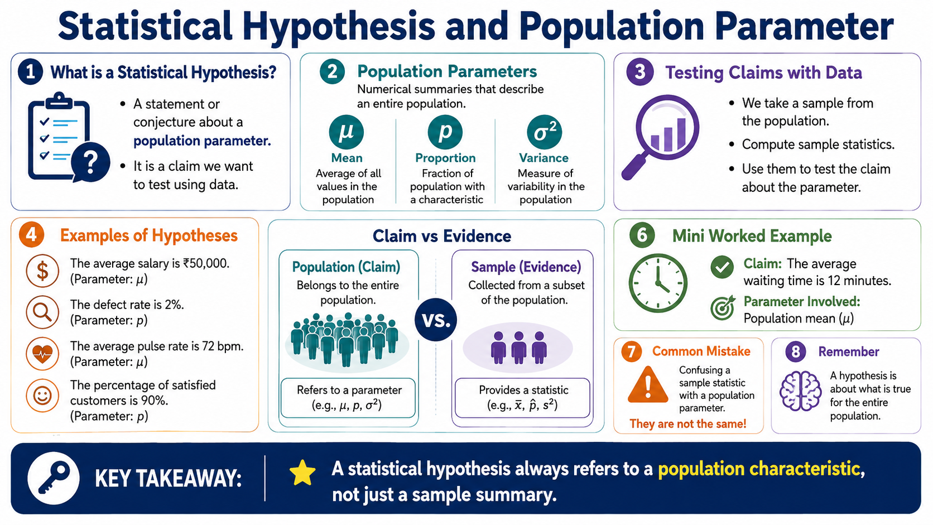
Statistical Hypothesis and Population Parameter
Module 1: Foundations of Hypothesis Testing
Infographic 2 of 16

Slide 5
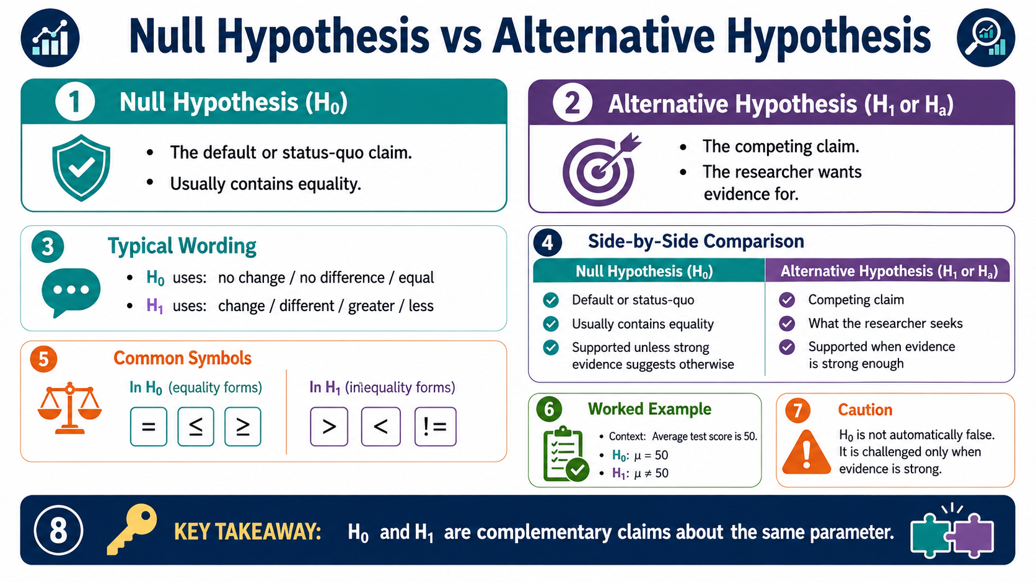
Null Hypothesis vs Alternative Hypothesis
Module 1: Foundations of Hypothesis Testing
Infographic 3 of 16

Slide 6
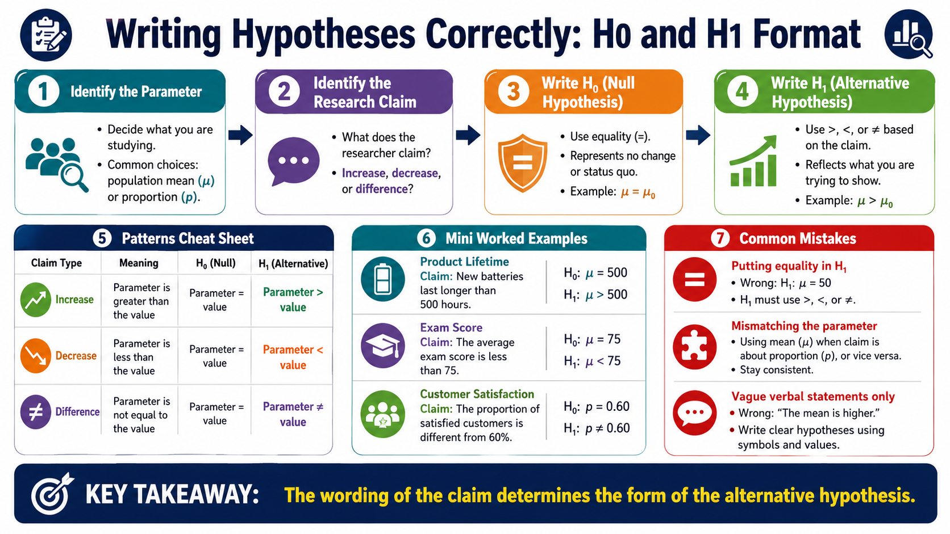
Writing Hypotheses Correctly: H₀ and H₁ Format
Module 1: Foundations of Hypothesis Testing
Infographic 4 of 16

Slide 7
Module 2: Types of Hypothesis Tests
4 infographic slides
Section 2 of 4

Slide 8
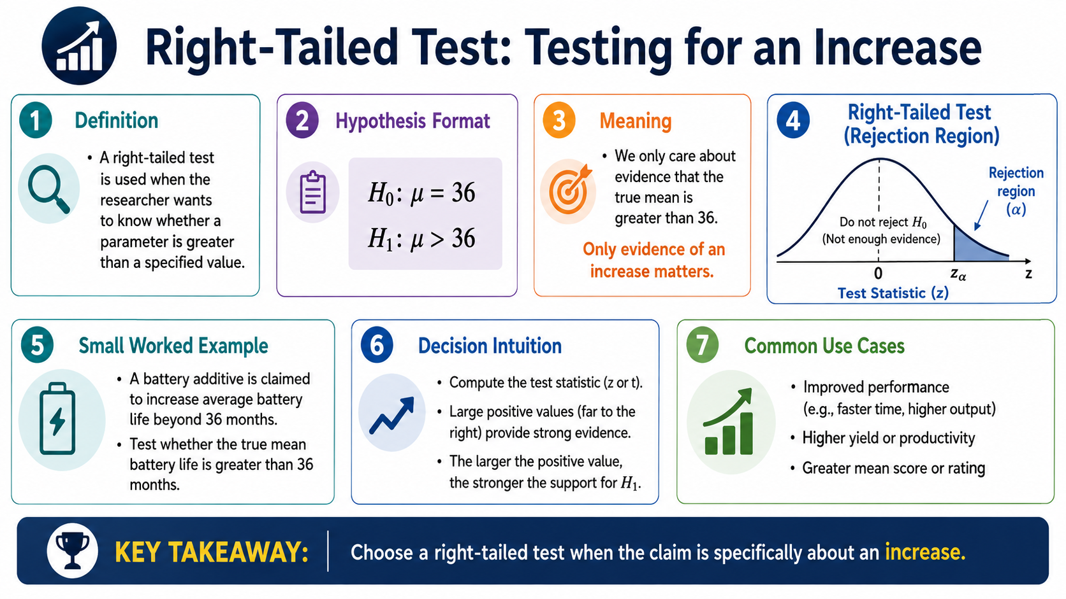
Right-Tailed Test: Testing for an Increase
Module 2: Types of Hypothesis Tests
Infographic 5 of 16

Slide 9
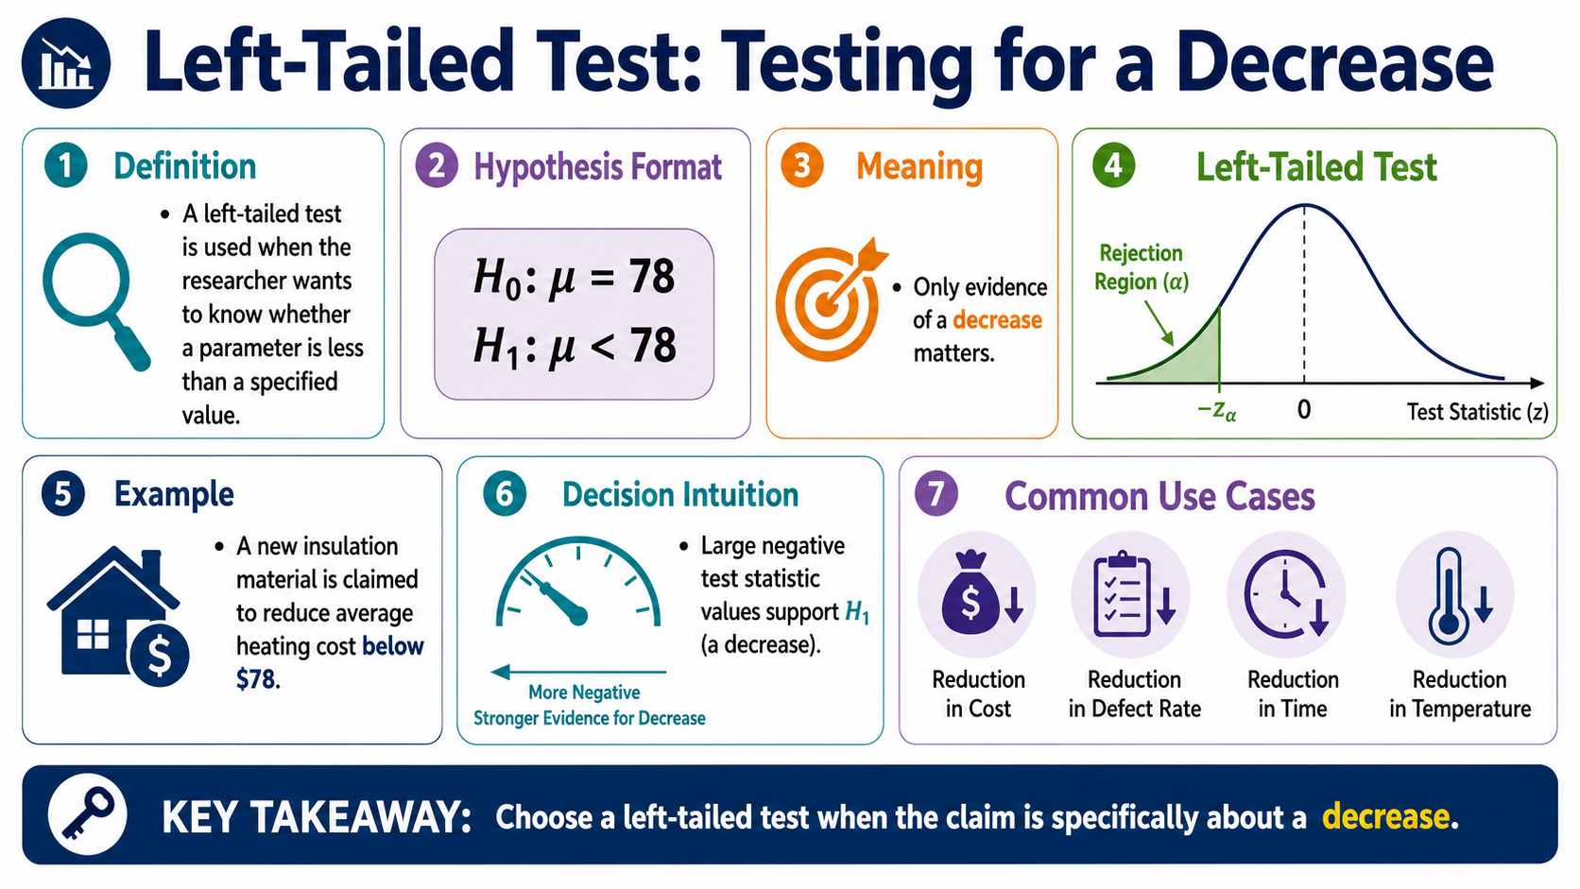
Left-Tailed Test: Testing for a Decrease
Module 2: Types of Hypothesis Tests
Infographic 6 of 16

Slide 10
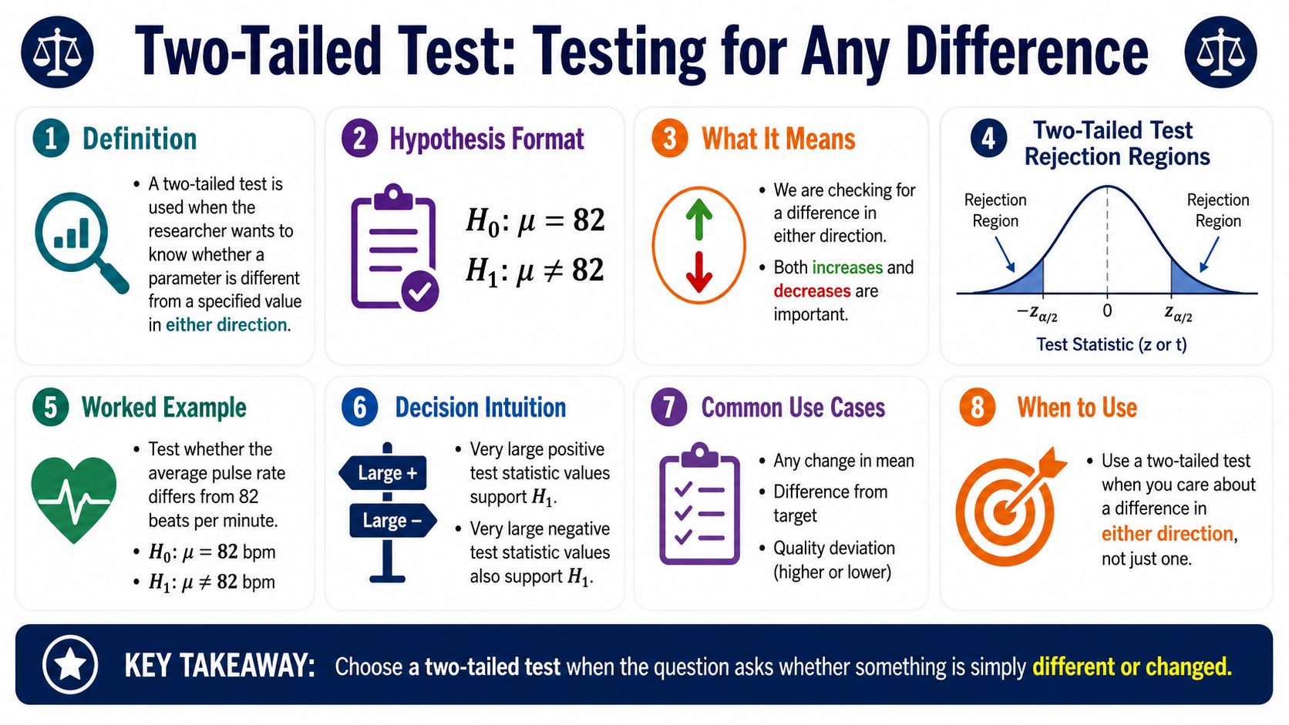
Two-Tailed Test: Testing for Any Difference
Module 2: Types of Hypothesis Tests
Infographic 7 of 16

Slide 11
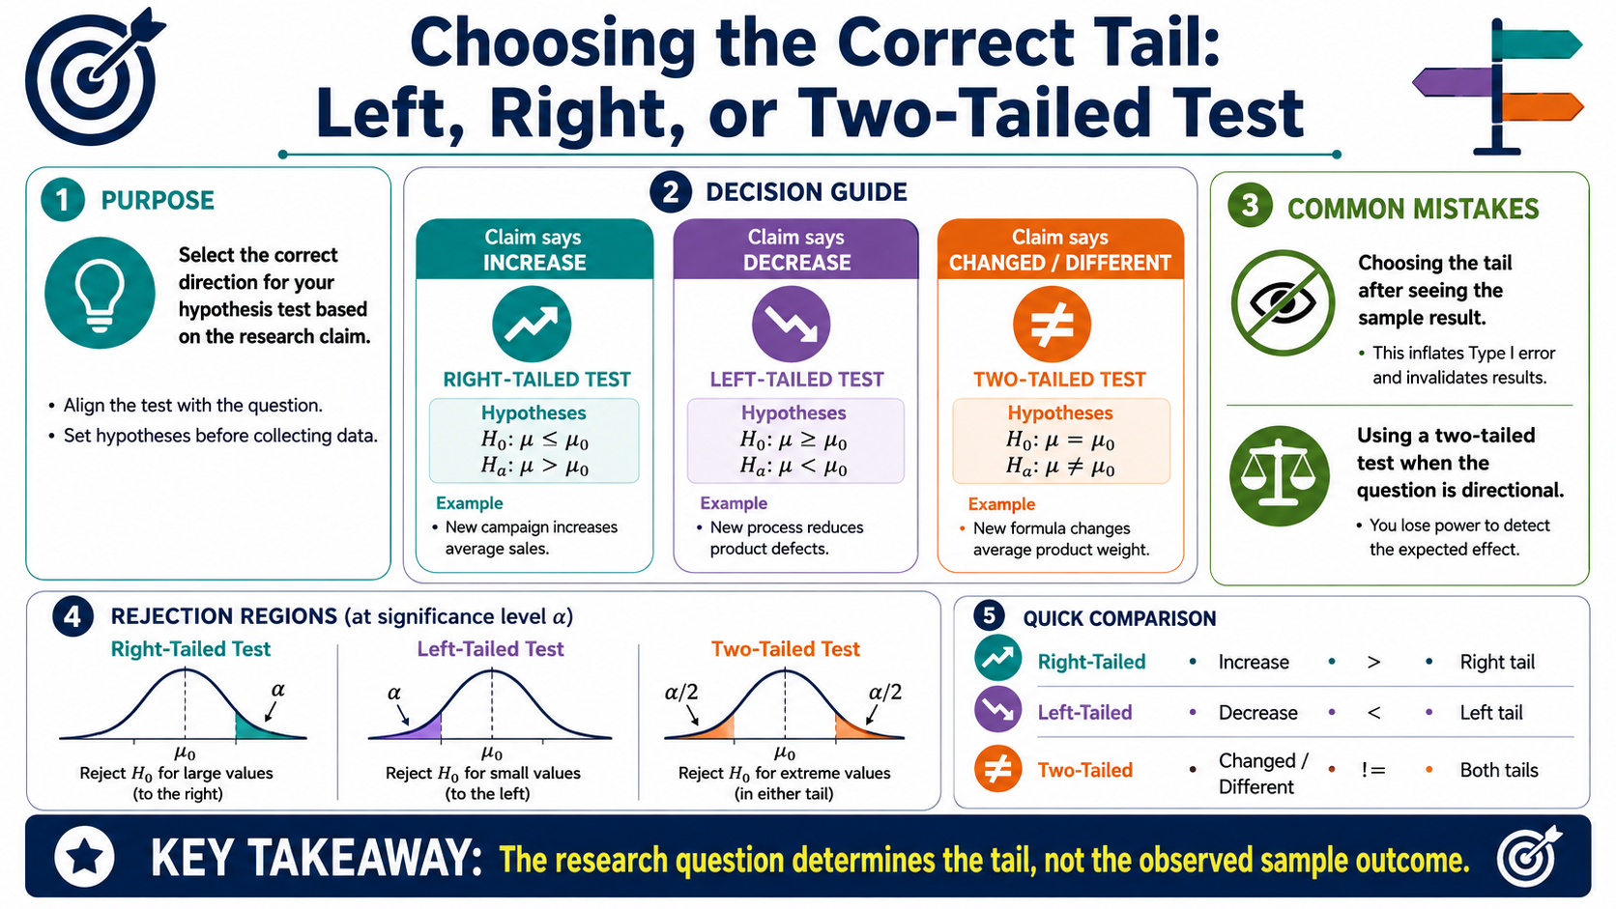
Choosing the Correct Tail: Left, Right, or Two-Tailed Test
Module 2: Types of Hypothesis Tests
Infographic 8 of 16

Slide 12
Module 3: Traditional Testing Method
4 infographic slides
Section 3 of 4

Slide 13
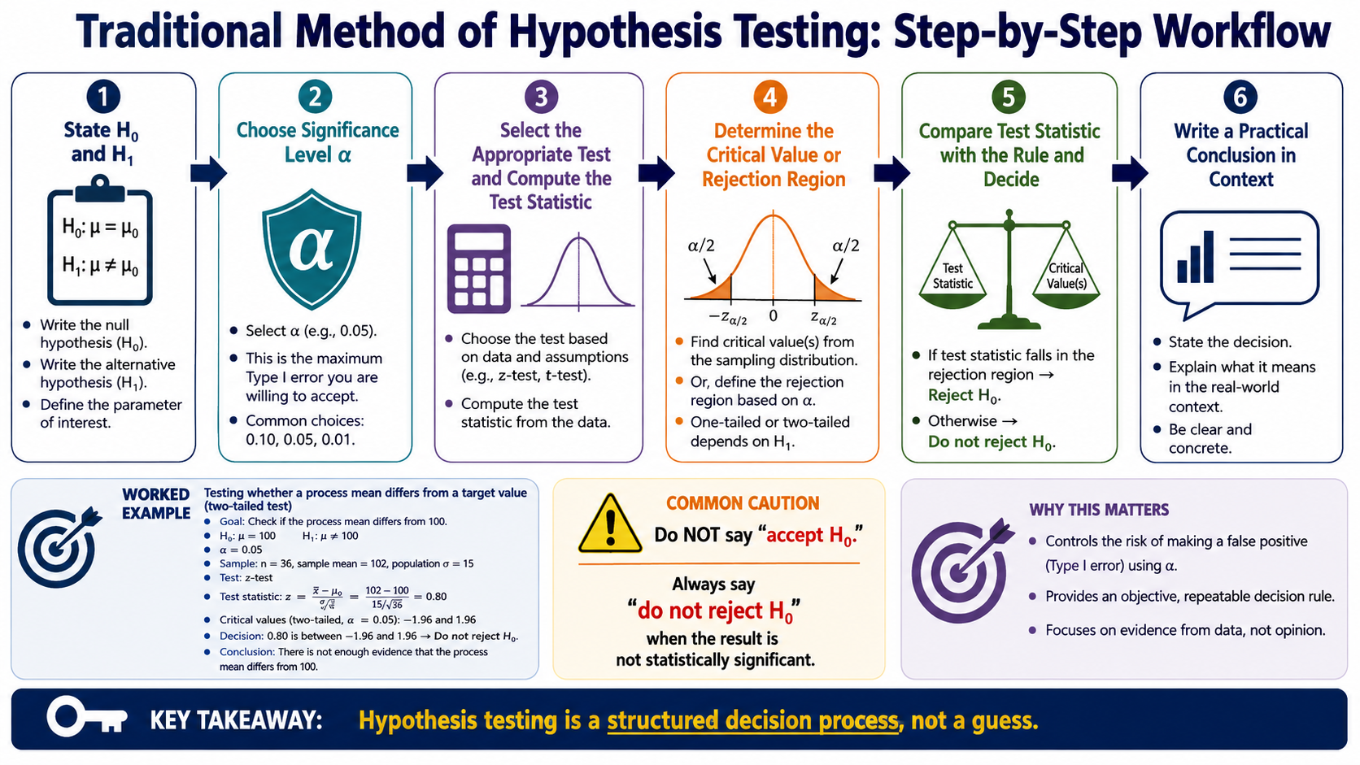
Traditional Method of Hypothesis Testing: Step-by-Step Workflow
Module 3: Traditional Testing Method
Infographic 9 of 16

Slide 14
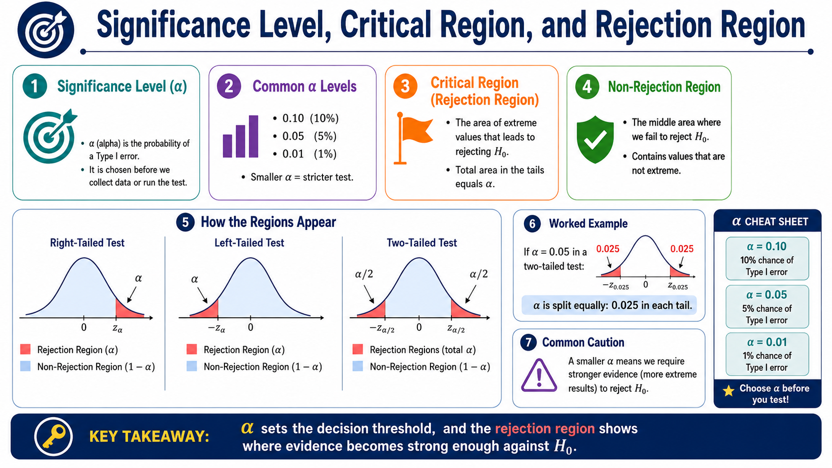
Significance Level, Critical Region, and Rejection Region
Module 3: Traditional Testing Method
Infographic 10 of 16

Slide 15
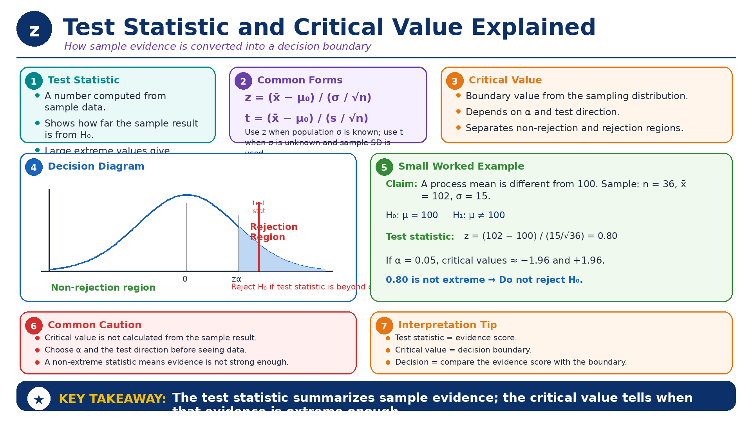
Test Statistic and Critical Value Explained
Module 3: Traditional Testing Method
Infographic 11 of 16

Slide 16
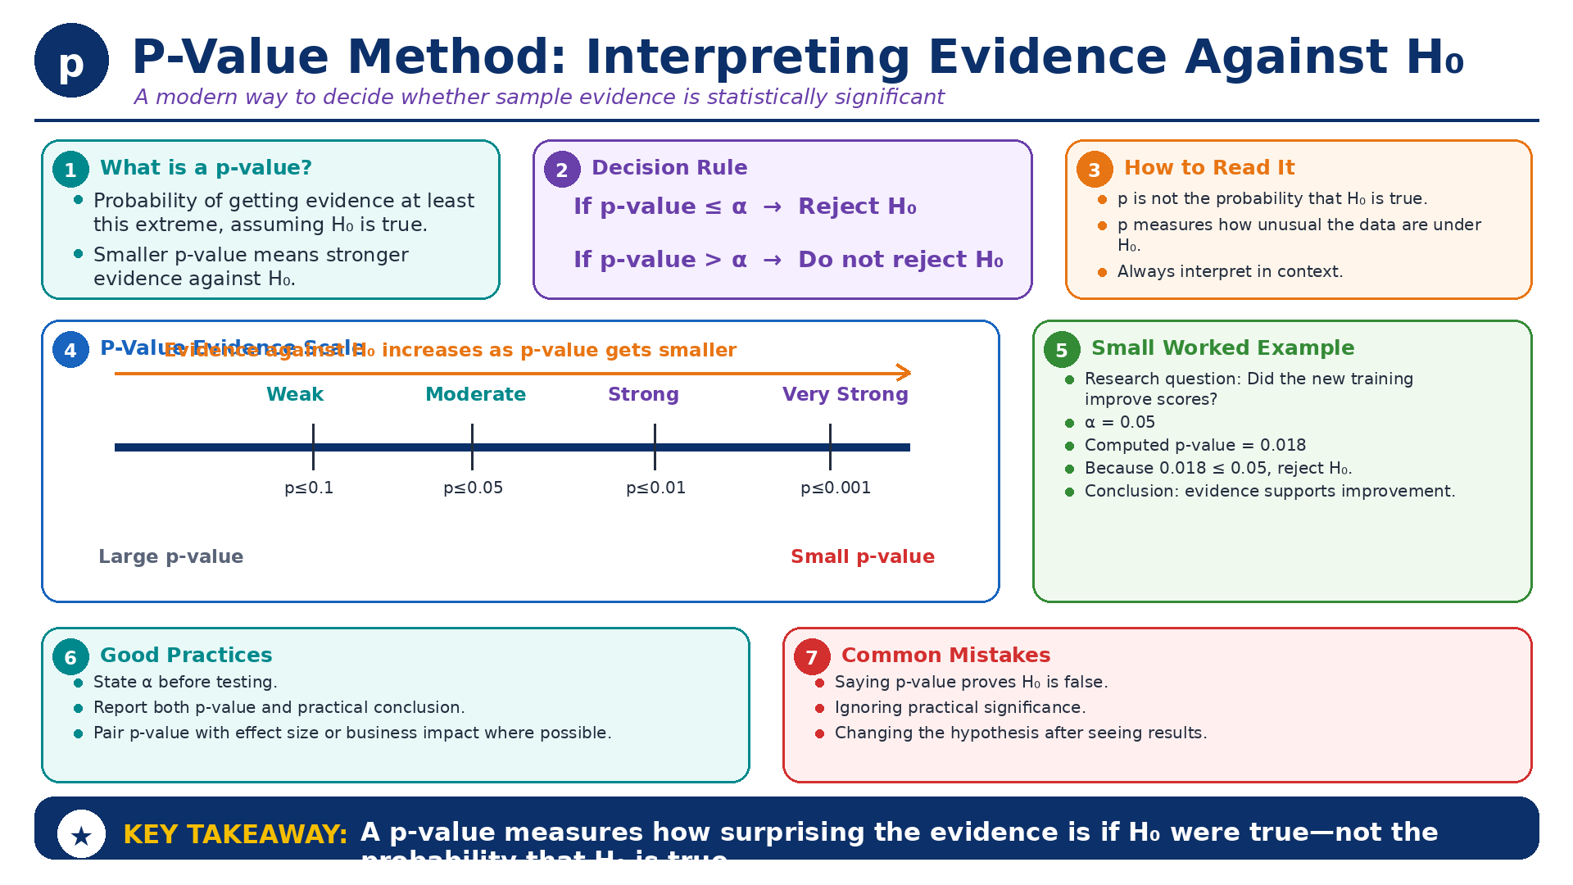
P-Value Method: Interpreting Evidence Against H₀
Module 3: Traditional Testing Method
Infographic 12 of 16

Slide 17
Module 4: Outcomes, Errors, and Interpretation
4 infographic slides
Section 4 of 4

Slide 18
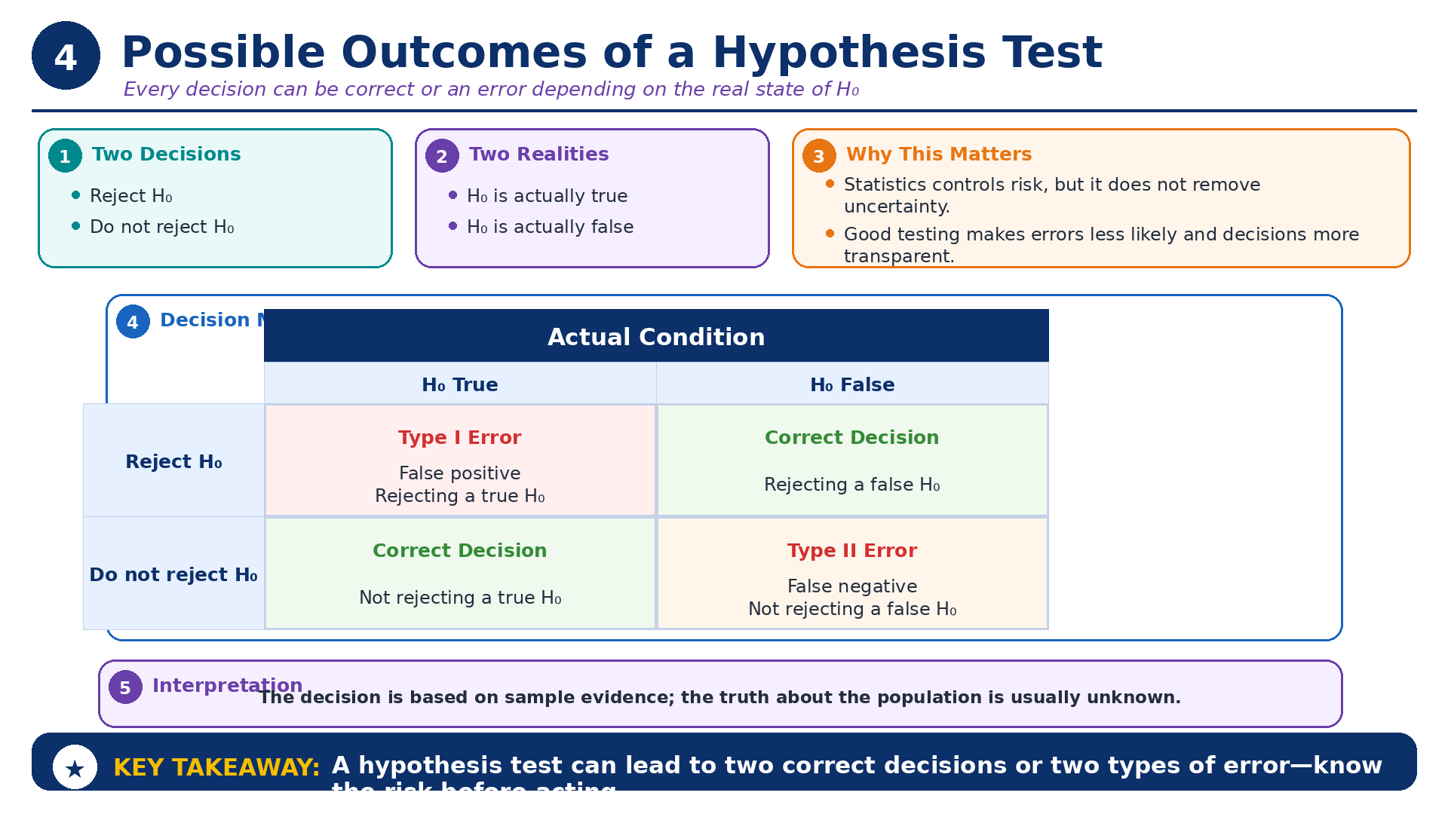
Possible Outcomes of a Hypothesis Test
Module 4: Outcomes, Errors, and Interpretation
Infographic 13 of 16

Slide 19
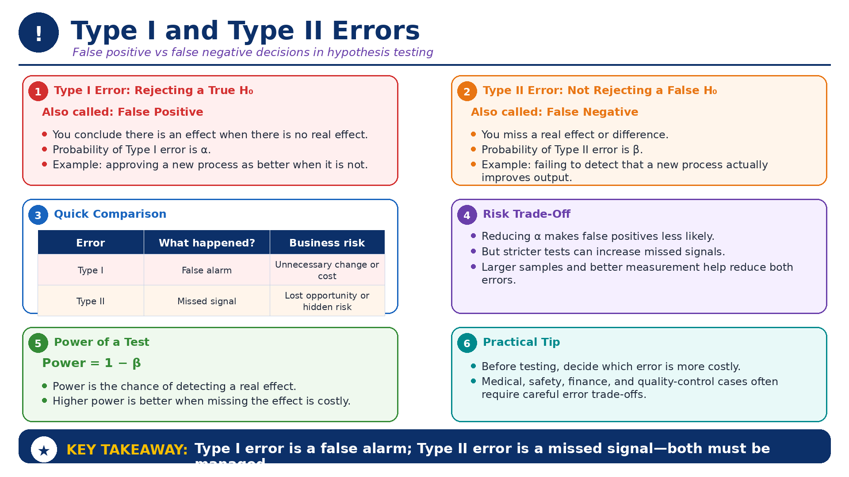
Type I and Type II Errors
Module 4: Outcomes, Errors, and Interpretation
Infographic 14 of 16

Slide 20
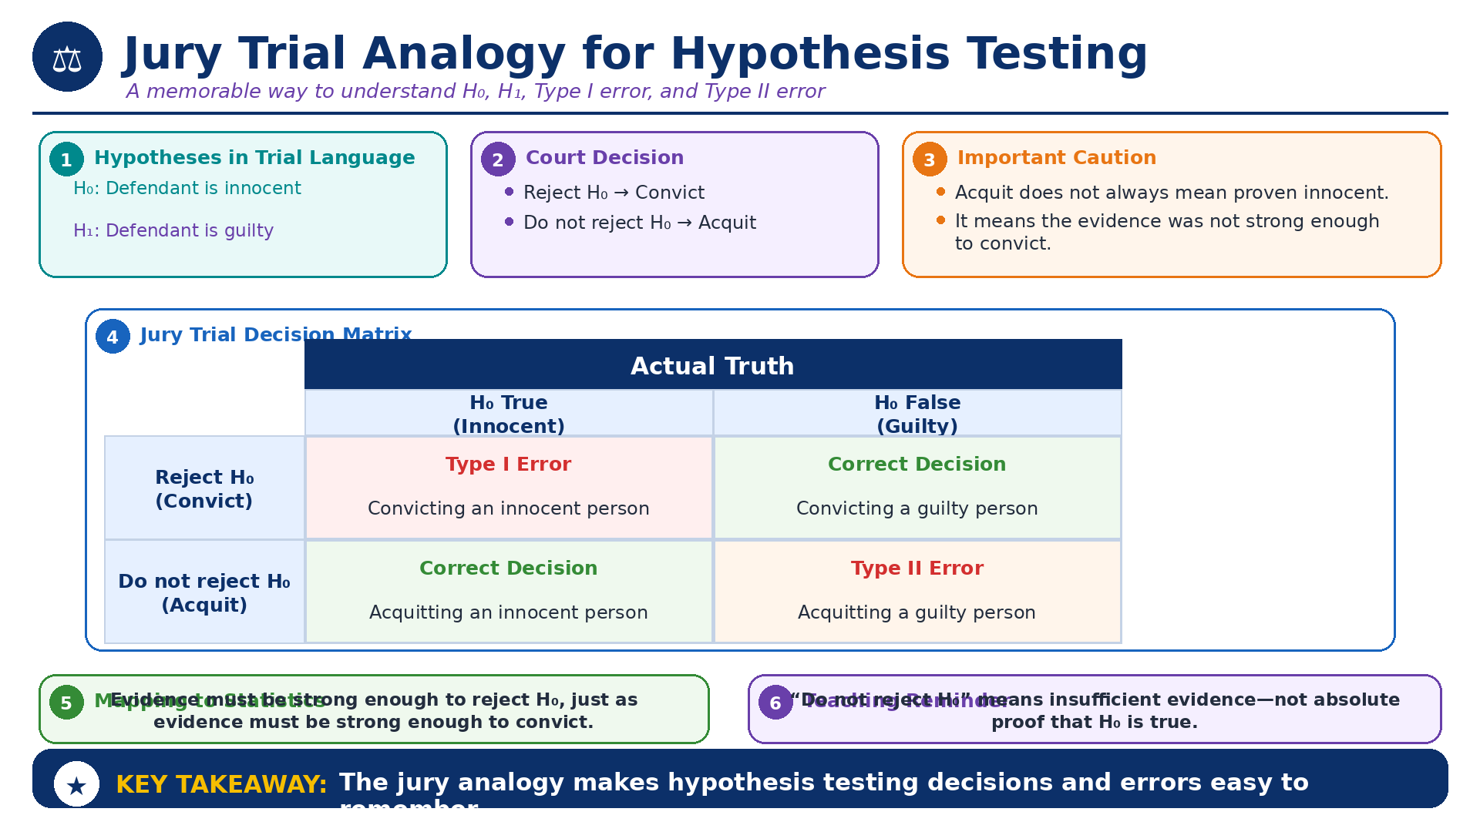
Jury Trial Analogy for Hypothesis Testing
Module 4: Outcomes, Errors, and Interpretation
Infographic 15 of 16

Slide 21
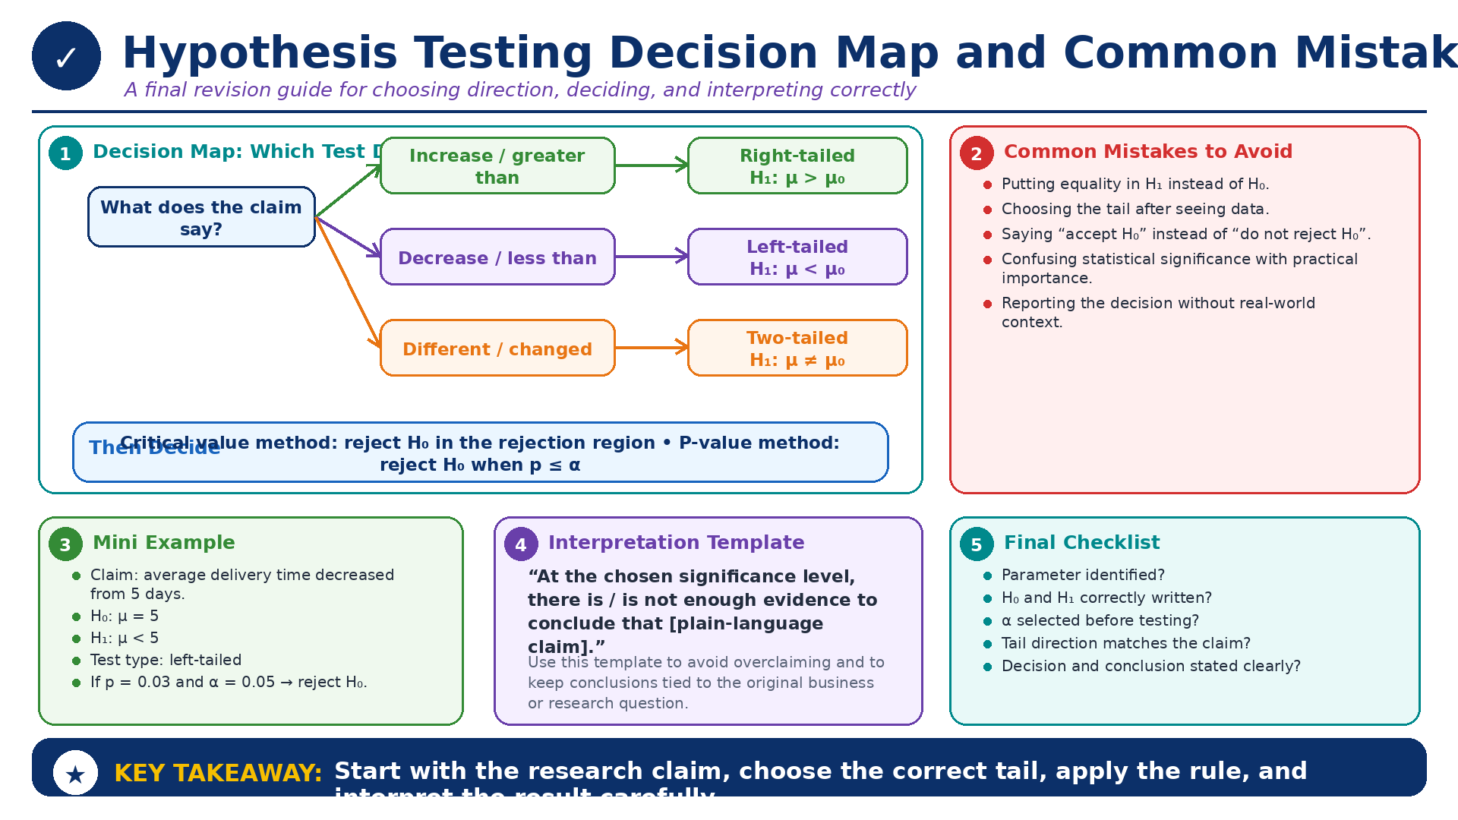
Hypothesis Testing Decision Map and Common Mistakes
Module 4: Outcomes, Errors, and Interpretation
Infographic 16 of 16

